Slide 1

MIS 281N
Data Management
Class 2 – Data Strategy, Ethics, Governance and Risk
Clint Tuttle
Senior Lecturer, The University of Texas at Austin
Brad Poynter
Lecturer, The University of Texas at Austin

Slide 2
Objectives
Data Management Components
Breakout Teams
Team Report Outs
Data management technology landscape
Ethics of Data
Questions and Discussion

Slide 3
Questions? Takeaways, Reflections, Questions

Slide 4
Illustrative Definitions
Gartner—Data Management is the set of practices, architectural techniques, and tools for achieving consistent access to and delivery of data across the spectrum of data subject areas and data structure types in the enterprise, to meet the data consumption requirements of all applications and business processes.
DalleMule & Davenport—A company’s data architecture describes how data is collected, stored, transformed, distributed, and consumed. It includes the rules governing structured formats, such as databases and file systems, and the systems for connecting data with the business processes that consume it. Information architecture governs the processes and rules that convert data into useful information.

Slide 5
Components of Data Mgmt
Business Purpose of Data
Characteristics of Data under Management
Data Management Operating Model
Data Management Technology Architecture

Slide 6
Business Purpose of Data
Multiple spectrums to characterize business purpose of data:
defense ←→ offense
internal ←→ external
”run the business” ←→ “grow the business”
…
Is your product/service based on data?
What is the role of data in your digitization roadmap?

Slide 7
Characteristics of Data under Mgmt
Internal – created through the execution of business processes
External – acquired as supplemental or a necessity for the business
Nature of transactional, streaming, reference, analytical and metadata
Volume?
Velocity?
Variety?
Regulation – requirements for privacy, access, and retention

Slide 8
Data Mgmt Operating Model
Four components of the operating model:
Organization
Governance
Stewardship
Performance management
Centralized or decentralized?
Sponsorship?
Roles and responsibilities?
Funding framework and philosophy?

Slide 9
Data Mgmt Technical Architecture
Dictated by first three components
Centralized and/or distributed?
Structured and/or unstructured?
Relational and/or non-relational
Type of unstructured data: text, images, audio, video, …
Requirements for Reliability, Availability, Serviceability, Usability, Installability (RASUI)
Requirements for security, privacy and retention

Slide 10
Team Exercise
You will be divided into 6 random teams
Each team will spend 15 minutes working as a team
Spend the first seven minutes discussing your answers to all the six questions
Spend the last 8 minutes preparing a 2 – 3 minute presentation for the question assigned to your team—you will be informed of your assignment
Appoint a spokesman for your team
Present and answer questions

Slide 11
Questions
After reading this paper, what are your initial thoughts regarding the scope and complexity of Data Management?
In your opinion, what should determine whether a company has a defensive or an offensive strategy?
In what situations will companies need both an offensive and a defensive strategy?
How would you use a company operating model to determine data strategy?
What technologies does a company need to adopt to support both an SSOT and an MVOT? Please explain your thinking.
Let’s say you end up working in one of the following companies. List whether you think they will have a defensive or offensive data management strategy based on what you have read in this article and why.
Dell Seton Medical Center at the University of Texas
Amazon
Chase Bank
Frito Lay
Tesla

Slide 12
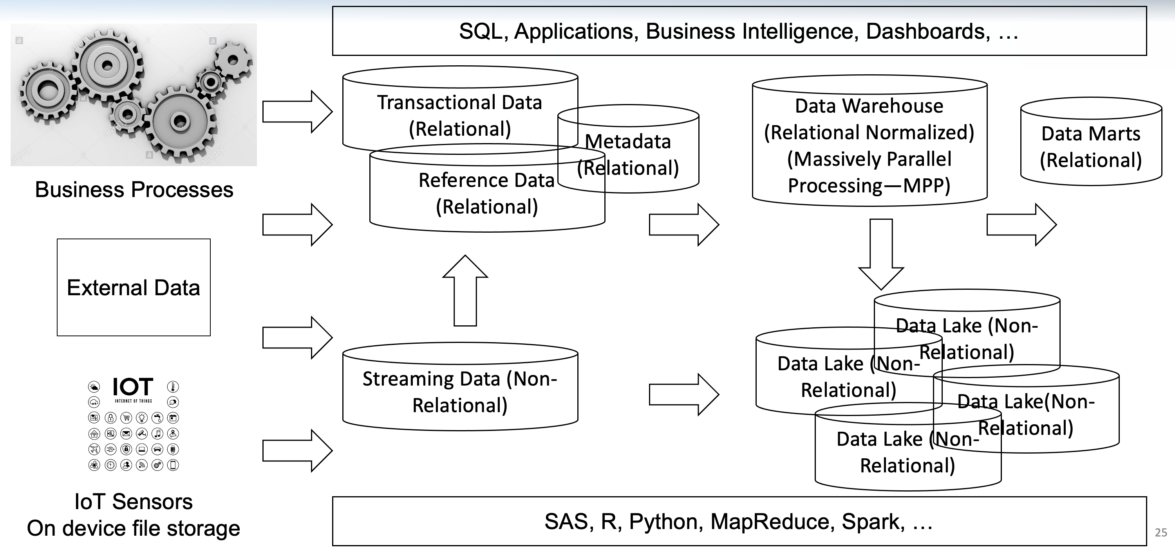
Typical Tech Ecosystem

Slide 13
Discussion
Is the Data Warehouse an example of SSOT or MVOT?
Is the Data Mart an example of SSOT or MVOT?
Is the Data Lake an example of SSOT or MVOT?
Answers
SSOT, MVOT, Both, Neither

Slide 14
Ethics of Data

Slide 15
Ethics of Data
Is data capture legitimate?
Is data access, interpretation and use legitimate?
Is predictive analytics with data thoughtful?

Slide 16
Is data capture legitimate?
The minimal amount of data required to run the business is captured
Informed consent is obtained from people providing the data
If data is requested that is not essential to provisioning the service – provide choice and provide the service if optional data is not provided
Include data covenants in corporate governance in the event of a change in control

Slide 17
Access, data interpretation, use
When provisioning access use the closed system model and minimum necessary principle
Review access appropriateness frequently and provide updates to the Board
Governance and stewardship to ensure appropriateness of interpretation
Integrate data with partner or externally purchased data only if this was disclosed during informed consent
Use the data only for the purposes disclosed in the informed consent

Slide 18
Predictive analytics
Learning from data – is their inherent bias in historical data? If yes, how can it be overcome?
Is the learning sample representative of the population we will apply the learning to?
Have we selected features for prediction that could have inherent bias?
Are we repeating history by learning from history? How do we account for new ideas and innovation?
Can humans understand the predictive model?
Who is responsible & accountable for errors?

Slide 19
Ethics of Data Discussion

Slide 20
Next Class
Always on Canvas
Takeaways, Reflections, Questions – Due Sunday night
SQL Developer Install and Getting Started Video
Readings on Relational DBs, Modeling and Normalization

